Slide 1
MODULE 3
INTRODUCTION TO FUZZY LOGIC, CLASSICAL SETS AND FUZZY SETS
Computer Science and Engineering, VJCET, Vazhakulam

Slide 2
INTRODUCTION
Fuzzy logic is an approach to computing based on "degrees of truth" rather than the usual "true or false" (1 or 0) Boolean logic on which the modern computer is based.
Why Fuzzy Logic?
  Fuzzy logic is useful for commercial and practical purposes.
  It can control machines and consumer products.
  It may not give accurate reasoning, but acceptable reasoning.
  Fuzzy logic helps to deal with the uncertainty in engineering.

Slide 3
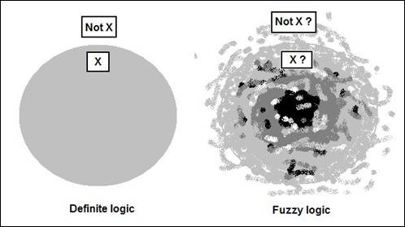

Slide 4
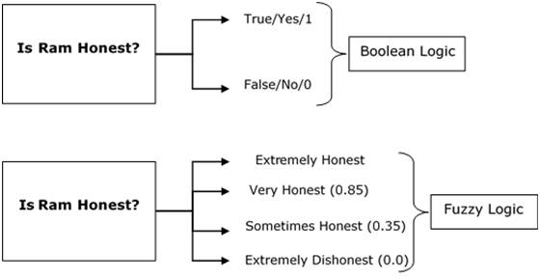

Slide 5
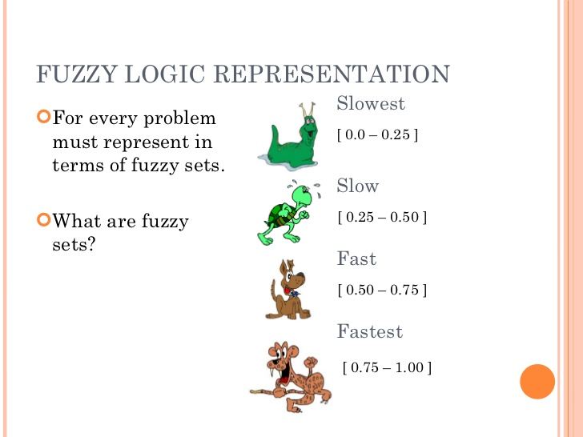

Slide 6
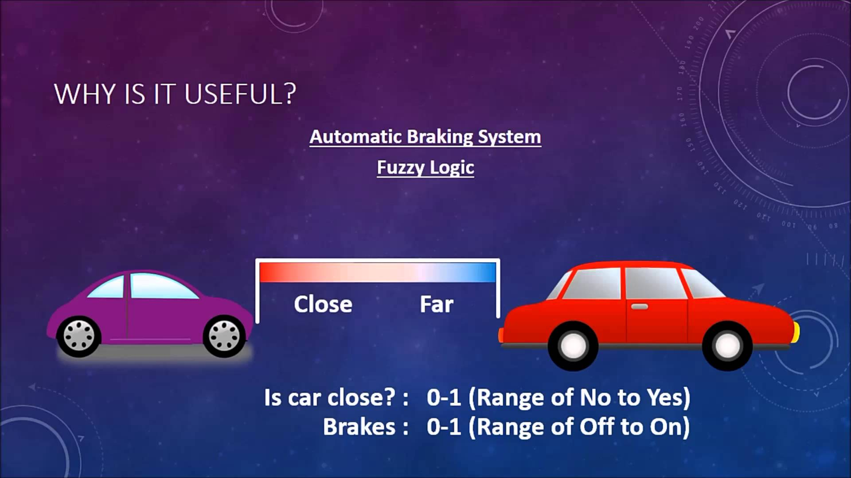

Slide 7
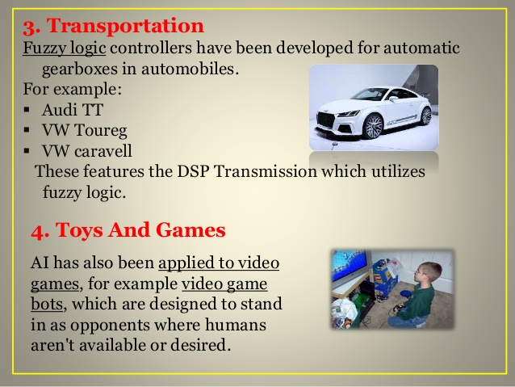

Slide 8
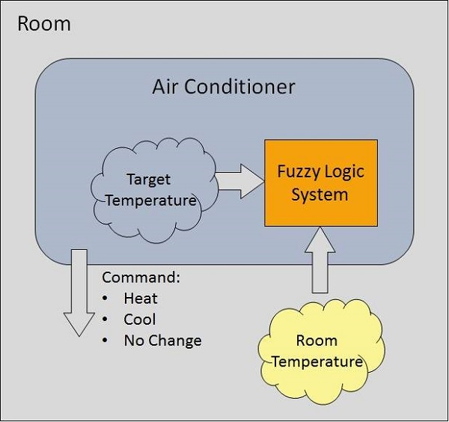

Slide 9
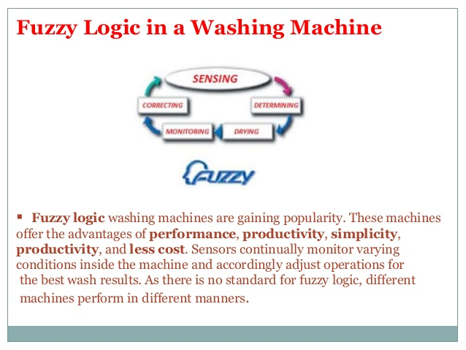

Slide 10
FUZZY LOGIC
  Fuzzy logic is the logic underlying approximate, rather than exact, modes of reasoning.
  It is an extension of multivalued logic: Everything, including truth, is a matter of degree.
  It contains as special cases not only the classical two-value logic and multivalue logic systems, but also probabilistic logic.
  A proposition p has a truth value
  0 or 1 in two-value system,
  element of a set T in multivalue system,
  Range over the fuzzy subsets of T in fuzzy logic.
Computer Science and Engineering, VJCET, Vazhakulam

Slide 11
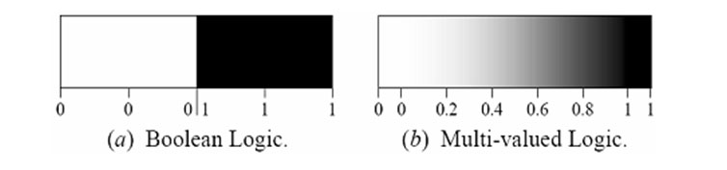
  Boolean logic uses sharp distinctions.
  Fuzzy logic reflects how people think.
  Fuzzy logic is a set of mathematical principles for
  Fuzzy logic is a set of mathematical principles for knowledge representation and reasoning based on degrees of membership.
Computer Science and Engineering, VJCET, Vazhakulam

Slide 12
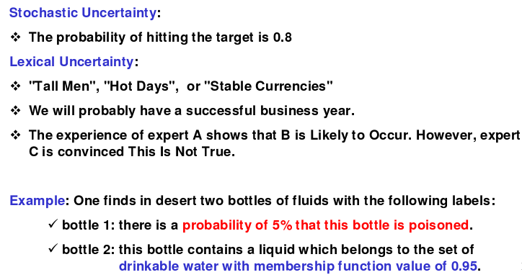
TYPES AND MODELING OF UNCERTAINTY
Computer Science and Engineering, VJCET, Vazhakulam

Slide 13
FUZZY vs PROBABILITY
  Fuzzy ≠ Probability
  Probability deals with uncertainty an likelihood
  Fuzzy logic deals with ambiguity an vagueness
Computer Science and Engineering, VJCET, Vazhakulam

Slide 14
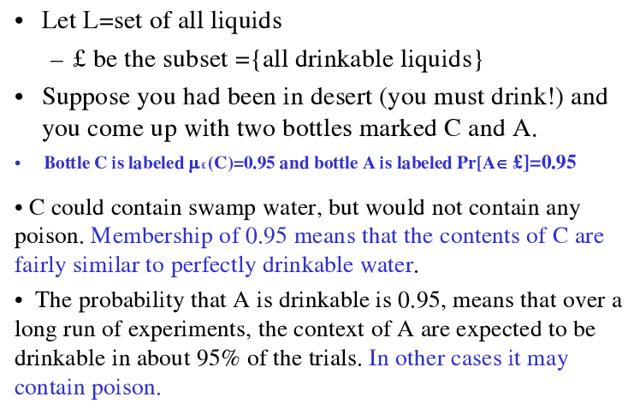
Computer Science and Engineering, VJCET, Vazhakulam

Slide 15
NEED OF FUZZY LOGIC
  Based on intuition and judgment.
  No need for a mathematical model.
  Provides a smooth transition between members and nonmembers.
  Relatively simple, fast and adaptive.
  Less sensitive to system fluctuations.
  Can implement design objectives, difficult to express mathematically, in linguistic or descriptive rules.
Computer Science and Engineering, VJCET, Vazhakulam

Slide 16
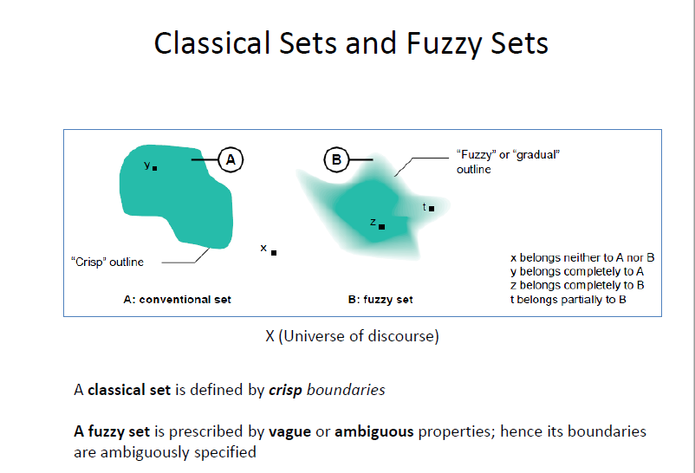

Slide 17
Classical Set/Crisp set
Collection of objects which share same characteristics
A classical set is the collection of distinct objects
Consider an object in the crisp set A. This object is either the member or nonmember of the given set A
In crisp set no partial membership exist
Let Universe of discourse be U.
The collection of elements in the universe is called whole set
The total number of elements in the universe U is called cardinal number denoted by n_{U}
Collection of elements within the universe is called set
Collection of elements within the set is called subset

Slide 18
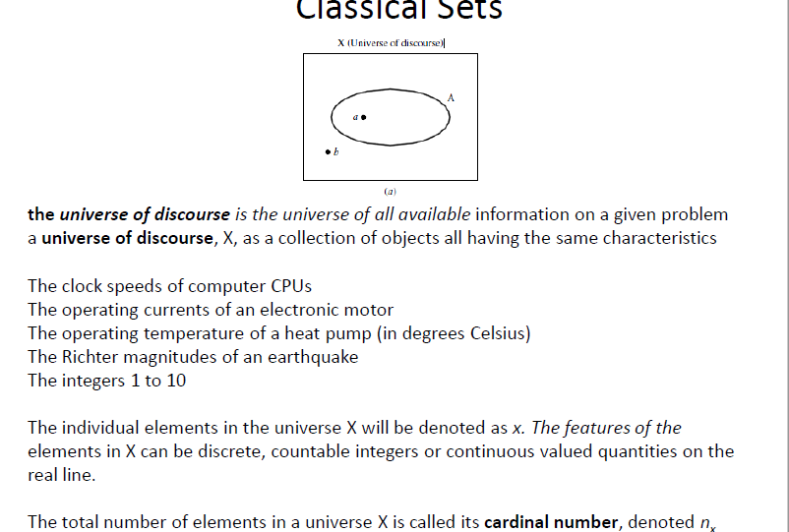

Slide 19
CLASSICAL SETS (CRISP SETS)
Conventional or crisp sets are Binary. An element either belongs to the set or does not.
{True, False}
{1, 0}
For the crisp set A in the universe U:
An object x is the member of given set A {x E A}, ie x belongs to A
An object x is not a member of the given set A {x not belongs to A}
Computer Science and Engineering, VJCET, Vazhakulam

Slide 20
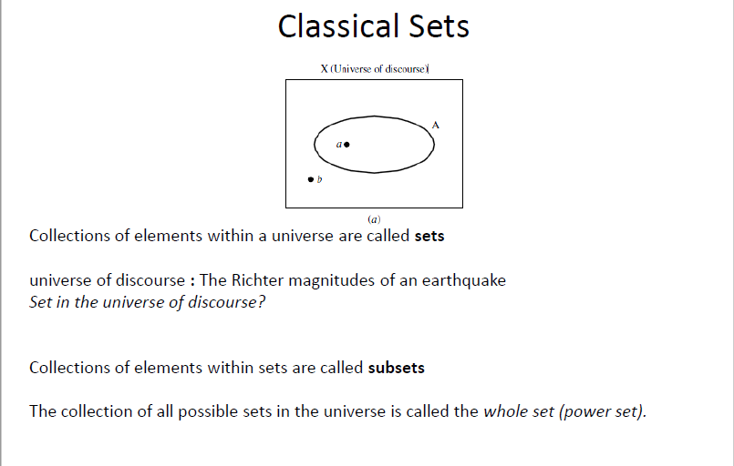

Slide 21
CRISP SETS
There are several ways for defining a set. A set may be defined using one of the following
  The list of all members of the set may be given. Example A={2,3,4,5}
  The properties of the set element may be specified
      Example A={x|x is prime number <20}
  The formula for the definition of the set may be specified
  The set may be specified on the basis of the result of the logical operation
  There exist a membership function, which may also be used to define a set. The membership is denoted by the symbol µ and the membership function for the set A is given by
      µ_{A}(x) =
1 If x belongs to A
0 If x not belongs to A

Slide 22
The set with no element is defined as an empty set or null set. It is denoted by Φ
The occurrence of an impossible event is denoted by null set, and the occurrence of the certain event indicate a whole set
The set which consist of all possible subset of a given set A is called power set and is denoeted by
    P(A)= {x| x ≤ A}

Slide 23
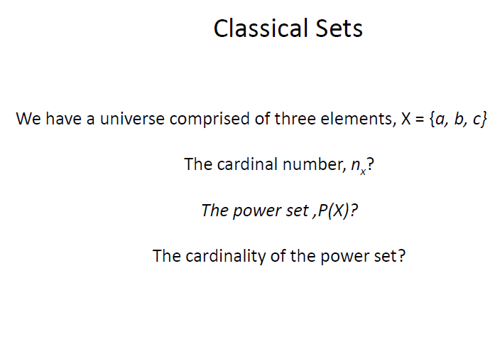

Slide 24



OPERATIONS ON CRISP SETS
UNION:
INTERSECTION:
COMPLEMENT:
DIFFERENCE:
Computer Science and Engineering, VJCET, Vazhakulam

Slide 25
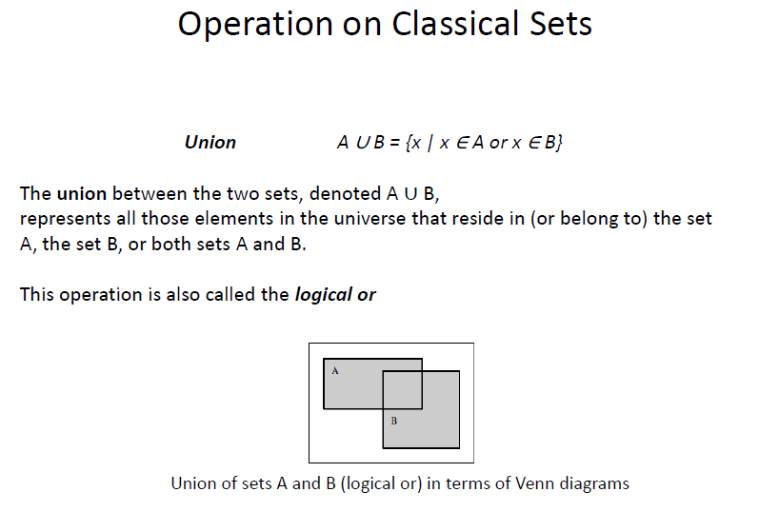

Slide 26
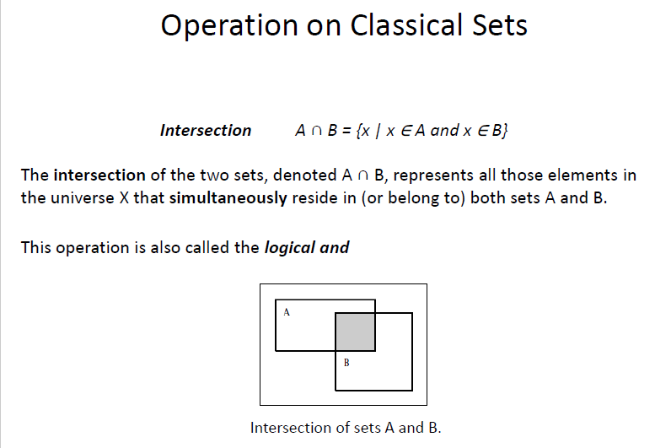

Slide 27
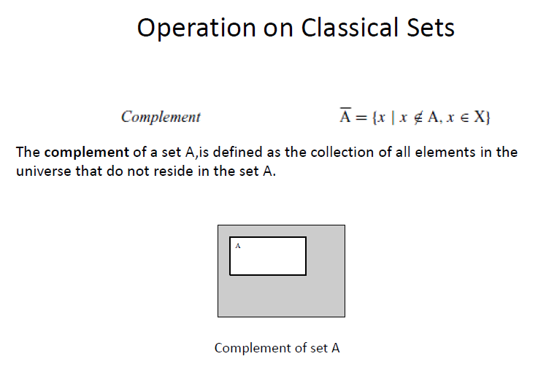

Slide 28
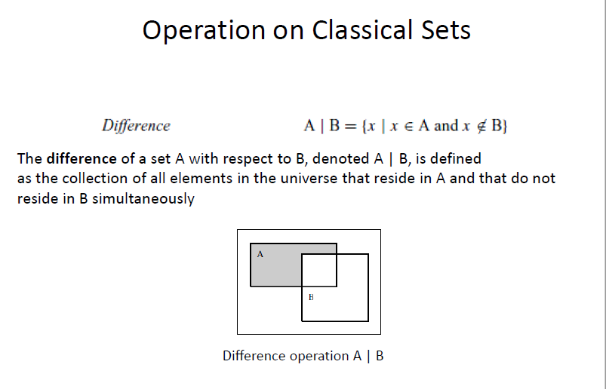

Slide 29
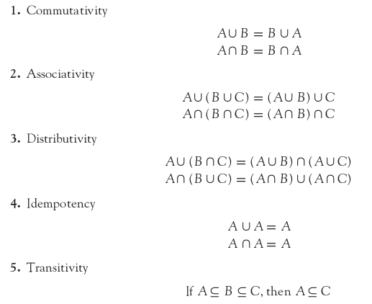
PROPERTIES OF CRISP SETS
The various properties of crisp sets are as follows:
Computer Science and Engineering, VJCET, Vazhakulam

Slide 30
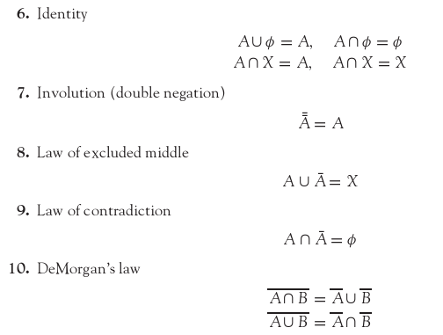
Computer Science and Engineering, VJCET, Vazhakulam

Slide 31
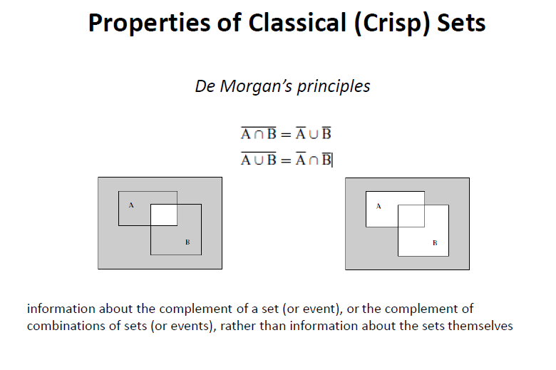

Slide 32
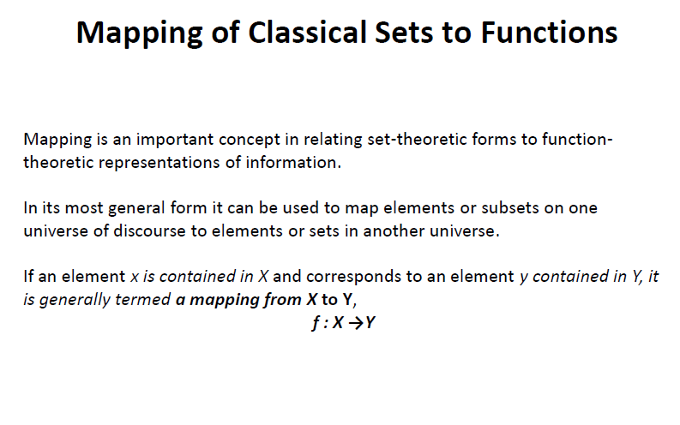

Slide 33
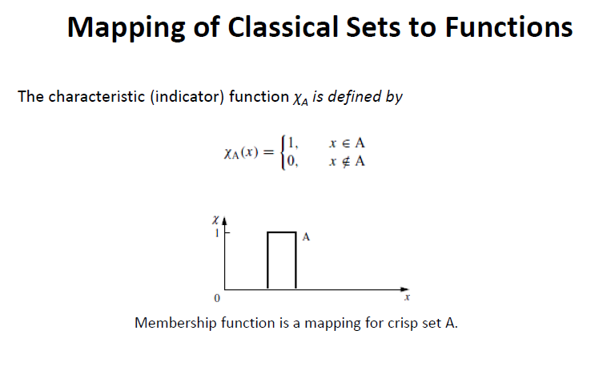

Slide 34
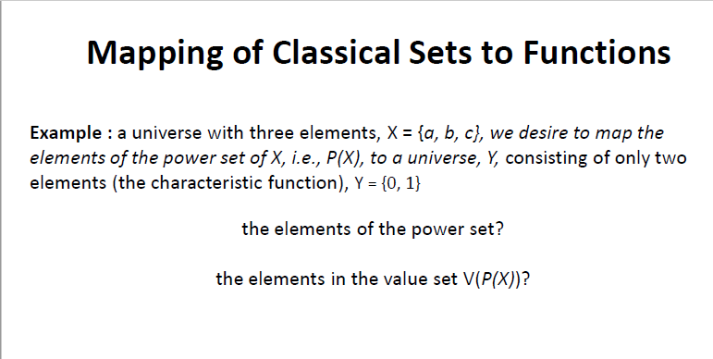

Slide 35
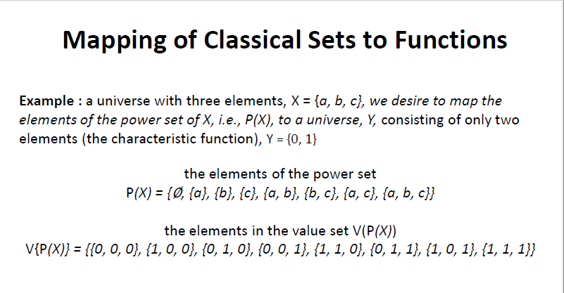

Slide 36
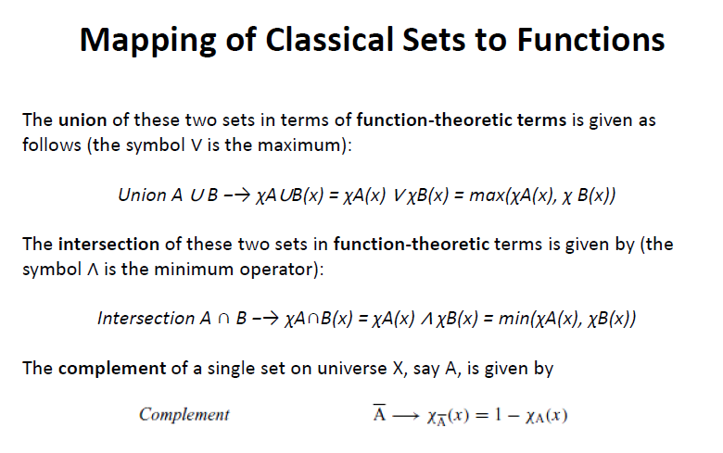

Slide 37
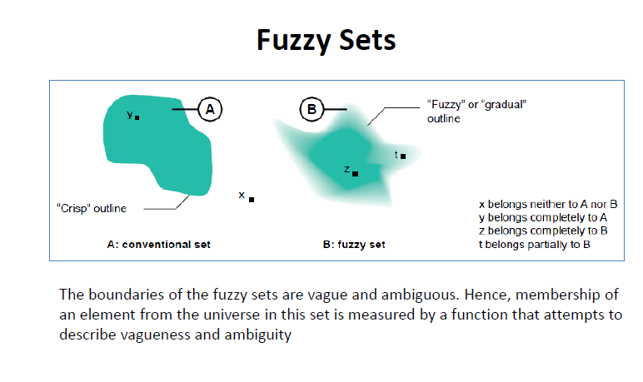
FUZZY SETS
Computer Science and Engineering, VJCET, Vazhakulam

Slide 38
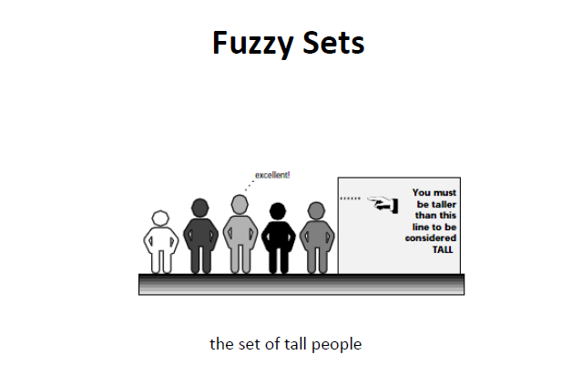
Computer Science and Engineering, VJCET, Vazhakulam

Slide 39
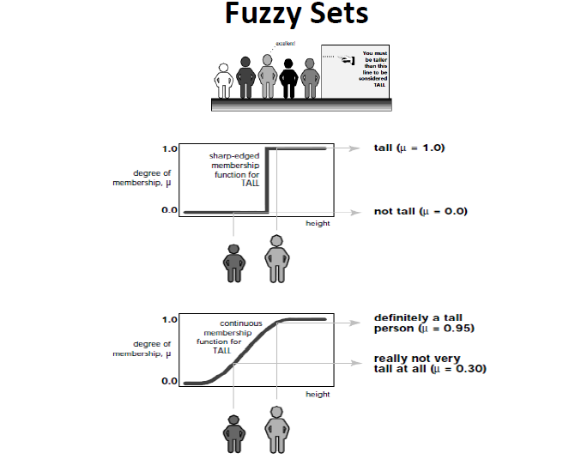

Computer Science and Engineering, VJCET, Vazhakulam

Slide 40
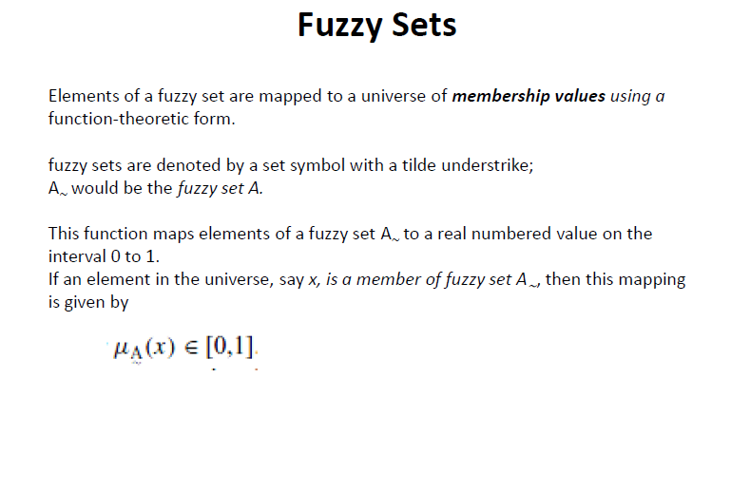

Slide 41
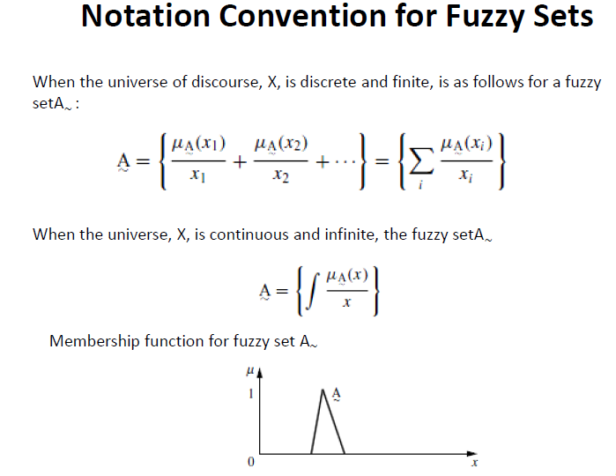

Slide 42
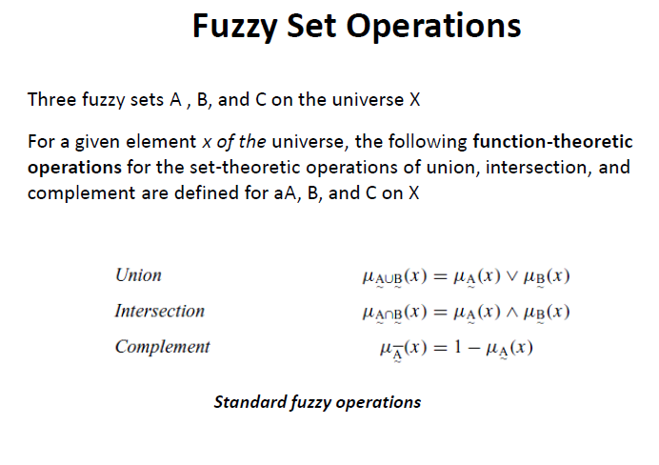

Slide 43
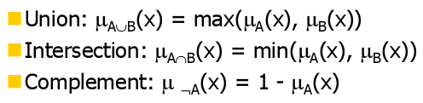
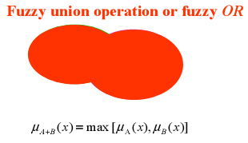
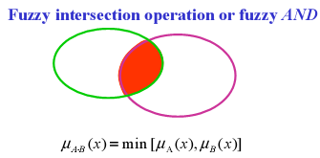
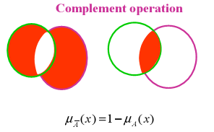
OPERATIONS ON FUZZY SETS
Computer Science and Engineering, VJCET, Vazhakulam

Slide 44
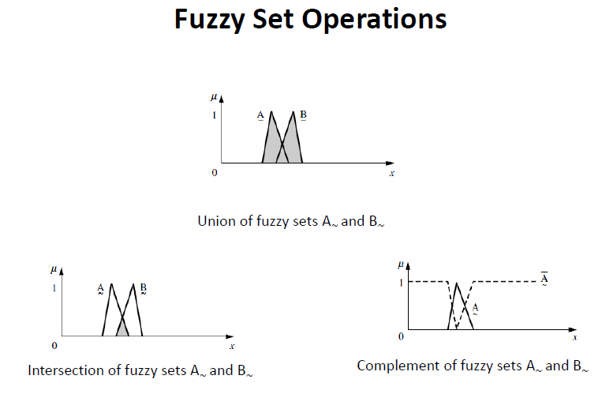

Slide 45
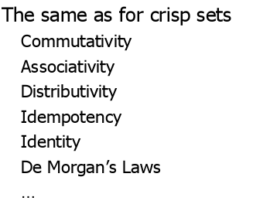
PROPERTIES OF FUZZY SETS
Computer Science and Engineering, VJCET, Vazhakulam

Slide 46
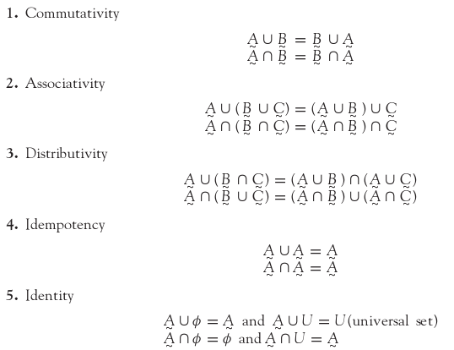
Computer Science and Engineering, VJCET, Vazhakulam

Slide 47
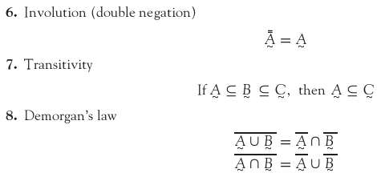
Computer Science and Engineering, VJCET, Vazhakulam

Slide 48
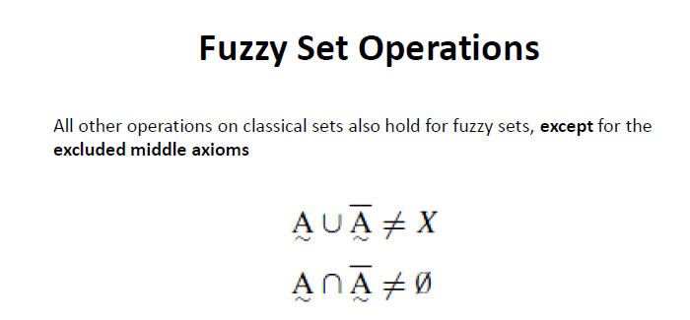

Slide 49
SUMMARY
This chapter discussed the basic concepts of fuzzy logic.
An introduction to crisp sets and fuzzy sets has been included.
The operations and properties of crisp sets and fuzzy sets are also dealt with.
Computer Science and Engineering, VJCET, Vazhakulam

